Slide 1




Pillars of object oriented programming

Slide 2
Inheritance

Slide 3

Inheritance is a fundamental concept in object-oriented programming (OOP) that allows a class to inherit attributes and methods from another class. It establishes a parent-child relationship between classes, where the child class (subclass) inherits the properties of the parent class (superclass).
The purpose of inheritance in OOP is to promote code reuse and to create a hierarchical structure of classes. By defining a superclass with common attributes and methods, subclasses can inherit and extend this functionality, while adding their own unique features.

Slide 4

Benefits of inheritance
It represents real-world relationships well.
It provides the reusability of a code. We don’t have to write the same code again and again. Also, it allows us to add more features to a class without modifying it.
It is transitive in nature, which means that if class B inherits from another class A, then all the subclasses of B would automatically inherit from class A.
Inheritance offers a simple, understandable model structure.
Less development and maintenance expenses result from an inheritance.

Slide 5
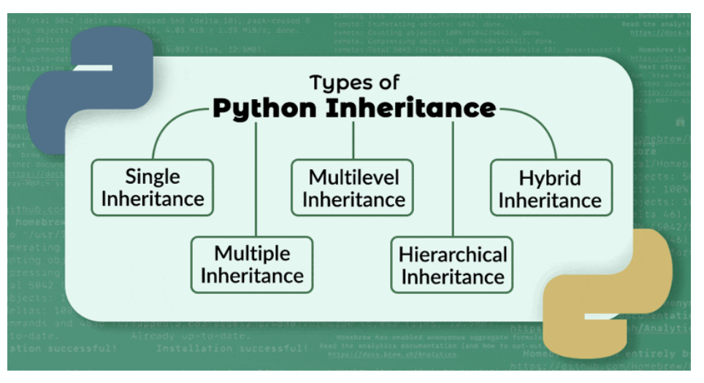

Slide 6
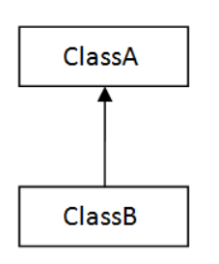
Single Inheritance
Single inheritance refers to the scenario where a class inherits from a single superclass. It forms a direct parent-child relationship.
In this type of inheritance, the subclass inherits the attributes and methods of the superclass.
Single inheritance allows for code reuse and promotes modularity by extending the functionality of the superclass.

Slide 7
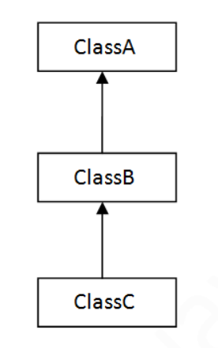
Multilevel Inheritance
Multilevel inheritance refers to the situation where a class inherits from a derived class, creating a chain of inheritance.
In this type of inheritance, a subclass becomes the superclass for another class, forming a hierarchy.
It allows for the propagation of attributes and methods through multiple levels of inheritance.

Slide 8
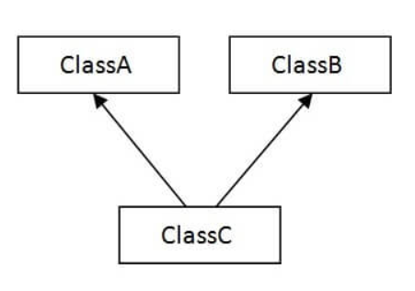
Multiple Inheritance
Multiple inheritance occurs when a class inherits from more than one superclass.
With multiple inheritance, a class can inherit attributes and methods from multiple super classes, combining their functionalities.
It allows for code reuse across different classes that share common characteristics.

Slide 9
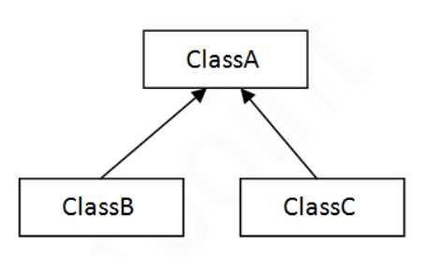
Hierarchical Inheritance
Hierarchical inheritance occurs when multiple subclasses inherit from a single superclass.
In this type of inheritance, the superclass serves as a common base for multiple subclasses, each having its own unique attributes and methods.
It allows for the specialization and customization of subclasses based on the common characteristics inherited from the superclass.

Slide 10
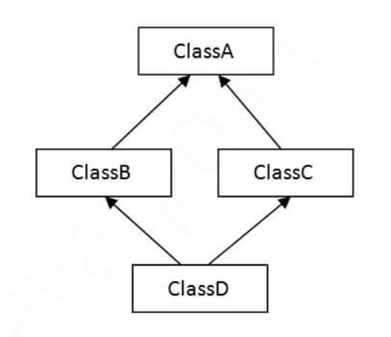
Hybrid Inheritance
Hybrid inheritance refers to a combination of different types of inheritance, such as single, multiple, or multilevel inheritance, in a single class hierarchy.
It involves the inheritance of attributes and methods from multiple super classes, forming a complex inheritance structure.
Hybrid inheritance allows for the advantages offered by different inheritance types and offers more flexibility in code organization.

Slide 11
Polymorphism

Slide 12
Introduction
Polymorphism is a fundamental concept in object-oriented programming (OOP) that allows objects of different classes to be treated as objects of a common superclass. It enables the same interface (method or function) to be used for objects of different types.
The purpose of polymorphism in OOP is to promote code flexibility, extensibility, and reusability. It allows for the development of generic code that can operate on objects of various types without needing to know their specific implementations.

Slide 13
Method overriding
Method overriding occurs when a subclass provides its own implementation of a method that is already defined in its superclass.
The subclass overrides the method to customize its behavior while maintaining the same method signature (name and parameters) as the superclass.
This allows for the specific behavior of an object to be determined by its actual type at runtime.

Slide 14
Method Overloading:
Method overloading involves defining multiple methods with the same name but different parameters within a class.
The methods have different parameter lists or types, allowing for different behaviors based on the arguments provided.

Slide 15
encapsulation

Slide 16
Encapsulation is a fundamental principle in object-oriented programming (OOP) that combines data and methods into a single unit called a class. It involves bundling related data and behaviors together and restricting direct access to internal components from outside the class.
The purpose of encapsulation in OOP is to achieve data hiding and abstraction. It allows the internal state (data) of an object to be protected from direct modification by external code and ensures that interactions with the object occur through well-defined methods (interfaces).
Encapsulation in Python enables the use of different access modifiers to control the visibility and accessibility of class members (methods and attributes)

Slide 17
Public methods and attributes:
Public methods and attributes are accessible from anywhere within the program.
They are declared without any access modifier or with the public keyword (although Python does not enforce strict access modifiers).
Example: def calculate(self):

Slide 18
Protected methods and attributes:
Protected methods and attributes are denoted by a single underscore prefix (_).
They are intended for internal use within the class or its subclasses.
Although not enforced by the language, it serves as a convention to indicate limited accessibility.
Example: _process_data(self):

Slide 19
Private methods and attributes:
Private methods and attributes are denoted by a double underscore prefix (__).
They are intended for exclusive use within the class itself.
The double underscore prefix performs name mangling, making the attribute or method less accessible outside the class.
Example: __validate_input(self):

Slide 20
abstraction

Slide 21
Abstraction is a key concept in object-oriented programming (OOP) that focuses on creating simplified and generalized representations of real-world objects or systems. It allows developers to hide complex implementation details and present only essential information or functionalities to the users.
Abstraction involves defining abstract classes or interfaces that provide a blueprint for derived classes while hiding the implementation specifics. It allows for the creation of a higher level of abstraction that focuses on what an object does rather than how it does it.
In Python, abstraction can be achieved through abstract base classes (ABCs) using the abc module. Abstract base classes cannot be instantiated directly but serve as a foundation for derived classes.

Slide 22
Key aspects of abstraction in Python:
Abstract Base Classes (ABCs): Abstract base classes are used to define abstract methods that derived classes must implement. They serve as a contract for derived classes, ensuring that certain methods are available for use.
Abstract Methods: Abstract methods are declared in abstract base classes but do not provide any implementation. Derived classes must override these methods and provide their own implementation.
Abstract Properties: Abstract properties are similar to abstract methods but represent properties instead of methods. They define the interface for accessing and modifying certain attributes in derived classes.
Abstract Classes: Abstract classes are classes that have at least one abstract method or property. They cannot be instantiated directly and require derived classes to provide the implementation for the abstract methods or properties.

Slide 23
Method Resolution Order (MRO) in Python
MRO determines the order in which methods are resolved in a class hierarchy.
It is crucial in multiple inheritance scenarios to avoid conflicts and ensure consistent method resolution.
MRO follows the C3 linearization algorithm, which combines depth-first search, left-to-right and child before parent order.
MRO ensures child classes are resolved before parent classes, preventing redundant method invocations.
MRO is important for method resolution, avoiding conflicts, and maintaining consistency in multiple inheritance.

